Slide 1

Senior Project Introductory Video
Summer 2016
Team Members: Eric Aguiar : Framework developer, Jorge Nonell : Framework developer , Alex Karpis : Device Developer , Christopher Naranjo : Device Developer
Product Owner: Dr. Francisco R. Ortega
Instructor: Masoud Sadjadi
School of Computing and Information Sciences
Florida International University

Slide 2
Previous system problems and limitations
Input devices are usually limited to the keyboard, mouse, joysticks, microphones, and imaging devices.
This project focuses on expanding the input from devices by exploring the input capabilities of devices, and integrating them into the Open HID Lab’s paint application for usage.
The problems of the previous project was a code framework that was unusable for device developers and no working knowledge of the devices for this project - the Xbox Kinect and the Hololens. It was also an issue that the application window could not be resized or exited from, and the menu layout was disorganized.

Slide 3
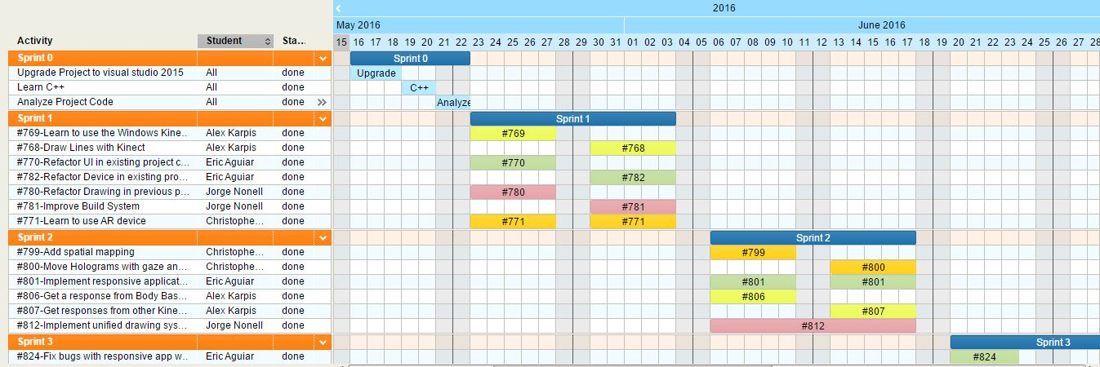
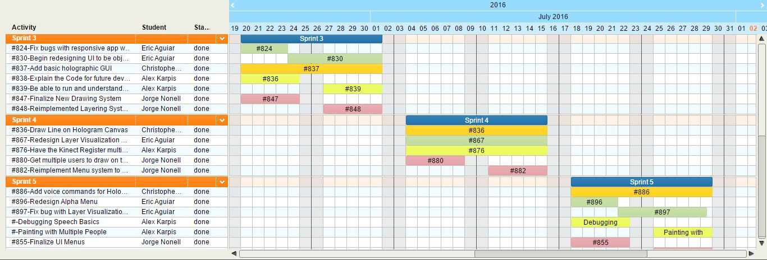
Project Management
These Gantt charts show the
work we did on the various
user stories that led
to the main ones and others.
We were glad as a team to get past the initial hurdles of
analyzing, learning, and
getting everything to work.
After that we were able to complete our
user stories from the
requirements.

Slide 4
Requirements
Developers should be able to add necessary information for painting without implementing the actual painting in an object oriented fashion.
Developers should be able to better understand the program.
Users should not experience any change because of the different structure.
The Users should be able to paint with the Kinect.
Users should be able to use some features of the hololens.
Users should be able to resize the window.

Slide 5
Main user stories
Add a basic holographic GUI.
Paint with the kinect
Add an event queue to the program
Resize windows in program

Slide 6
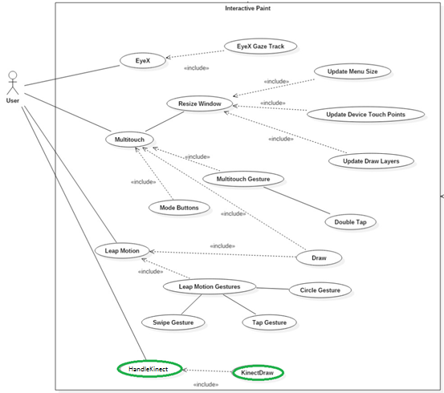
Use Cases
Use Case – Draw with the Kinect
The users will be able to Paint Lines using the Kinect.
Actors: Inherited from Paint use case.
Entry Condition:
This use case start when:
Inherited from the Paint use case
The user has notified the system they are using the Kinect.
Flow of events:
1. The user requests the Kinect be activated.
2. The system activates the Kinect and notifies the user.
3. The user takes the action for painting lines in the paint program with the Kinect.
4. The system paints when the user performs the paint action.
Exit Condition:
Inherited from the Paint use case.

Slide 7
Use case #1 – Use buttons to remove layers from canvas
Tap on button in world to remove a layer on canvas.
Details
Actor: User, Developer
Pre-conditions:
- “Holo-paint” installed on HoloLens
- Facing a direction with a wall at least 5m away (to start app)
- Canvas active in world
Description
Begins whenever a user starts the program and has an active canvas
Ends when a user taps on a button to remove a layer from the world
Post-conditions
Specific layer (mapped to a color for now) should no longer be visible.
▪ User should be able to remove specific layers from the world as they see
fit to more accurately interact with it

Slide 8
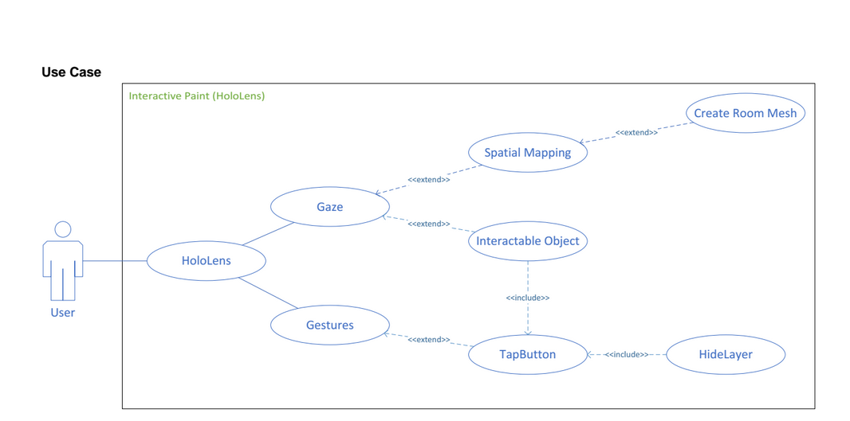

Slide 9
Use Case #801 – Implement a responsive windowed view of the application
Use Case:
Implement a responsive windowed view of the application
Details:
Actor: User
Pre-conditions:
Project working on VS2015
Program Running
Description:
Use case begins anytime a user runs the program and the application opens into a window (instead of full screen). This will affect the users control over the program window and size .
The user story ends when the user resize the window responsively without affecting the user's drawings.
Post-conditions:
A user can now minimize, maximize, and resize the windows as needed.
Decision Support:
Frequency: Often. Developers need to easily understand code
Criticality: High. Enables developers to work more efficiently
Risk:Low. Team members need to get used to new structure
Constraints:
Reliability: Very Reliable.
Performance: There may need to be performance improvements
Supportability: Must work with ACER Multitouch, Leap, RealSense and Eyex

Slide 10
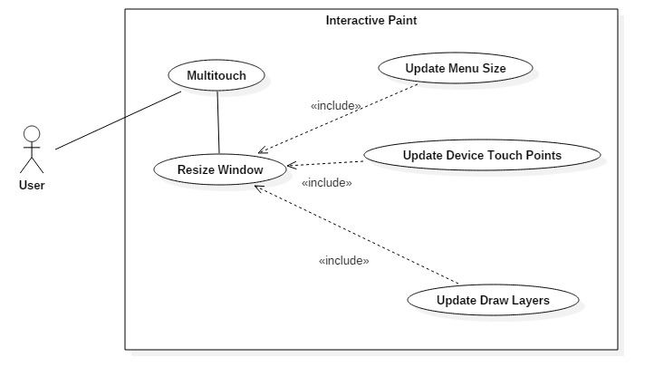

Slide 11
Use Case #812 – Implement and design a unified interface for devices to be able to hand off drawing to the application.
Use Case:
Design and implement a unified interface to allow all devices to draw
Details:
Actor: developer
Pre-conditions:
Project working on VS2015
Description:
If I want to add a new device, I can handle the input in a unified way across all devices.
When writing a device handler I should not need to know how the application.
Decision Support:
Frequency: Often. Developers need to easily understand code
Criticality: High. Enables developers to work more efficiently
Risk:Low. Team members need to get used to new structure
Constraints:
Reliability: Very Reliable.
Performance: There may need to be performance improvements
Supportability:
Must work with ACER Multitouch, Leap, RealSense and Eyex

Slide 12
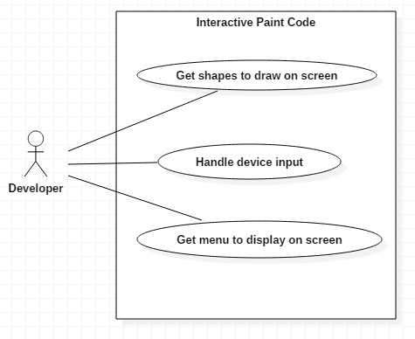

Slide 13
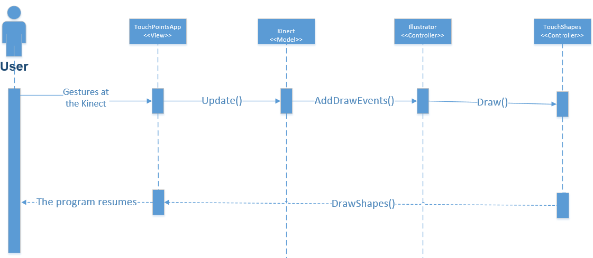
UML Sequence Diagrams

Slide 14
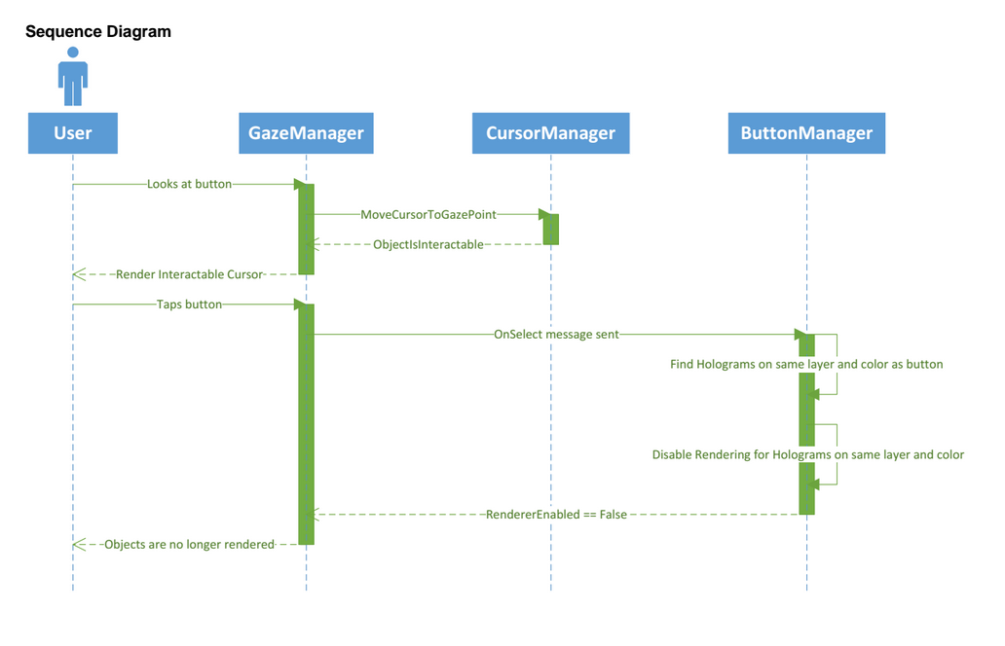

Slide 15
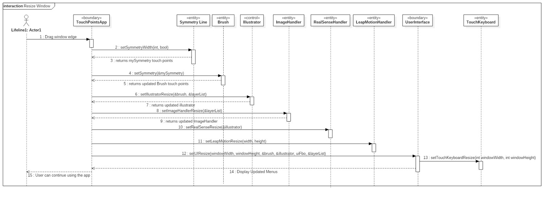

Slide 16
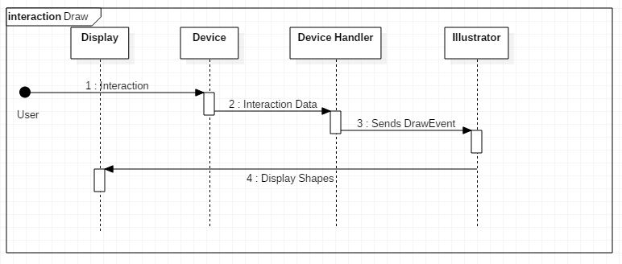

Slide 17
System Decomposition
The Model or main objects of the TouchPointsApp are the buffers (in the summer we used event buffers for the kinect) that are given the draw events from Cinder and the other devices.
The View is the cinder application window itself which is drawn on with openGL functionalities.
The Controller are the various header files, functions, and variables that control the information between the event buffers and the application.
Mainly, the buffers go to Illustrator which sends the events to TouchShapes, which determines what shape to draw and how to draw it using the draw method of each shape. All of the other code is used for supporting this process.

Slide 18
System Deployment
Windows computer
Visual Studio 2015
TouchScreen
Clone github and the dependencies
Desired compatible hardware devices

Slide 19
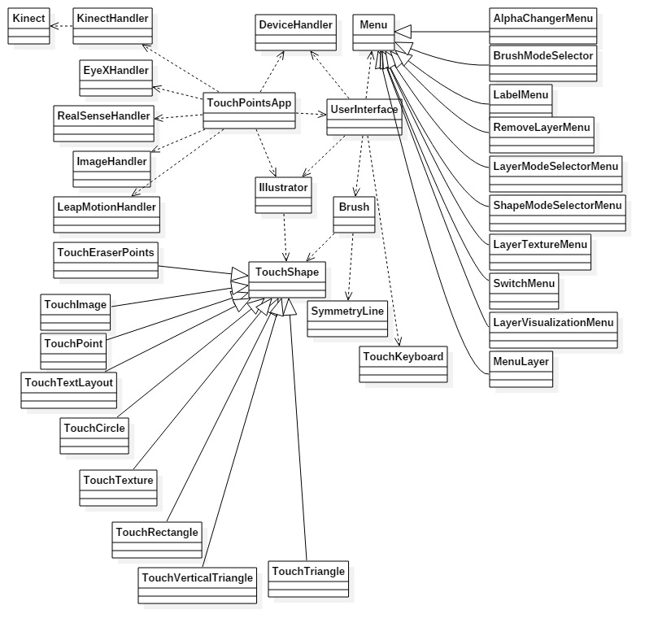
Class Diagram

Slide 20
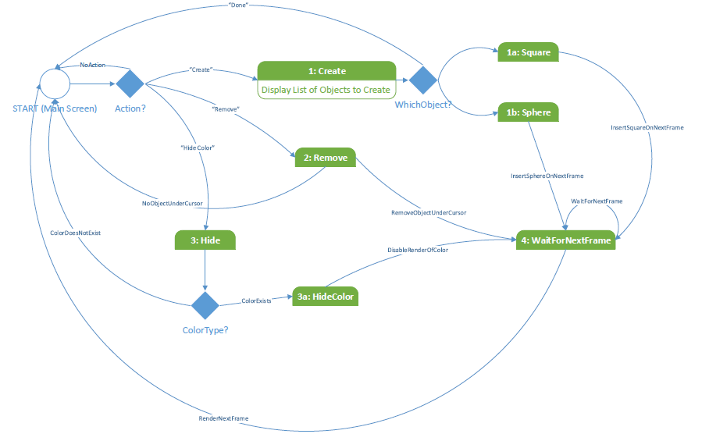
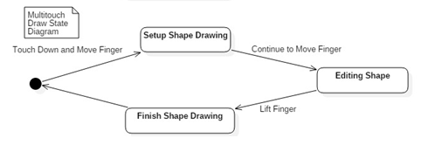
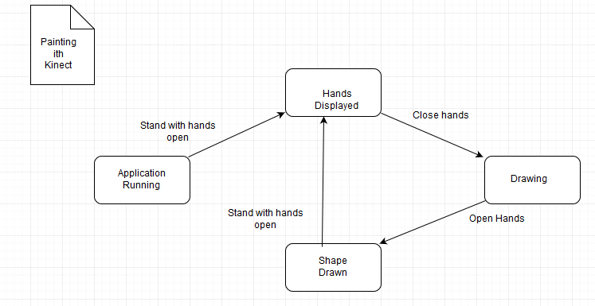
State Machines

Slide 21
Main Algorithm
If action is not draw
If finalizeable has startpoint
Set finalizeable endpoint
Push to illustrator
If action is draw
If finalizeable has startpoint
If temporary has startpoint
Set temporary endpoint
Push temporary to illustrator
Else
Create a temporary draw event from the temporary startpoint and current point
Else
Create a finalizeable draw event from the current point
if (sendToIllustrator.size() > 0)
illustrator.addDrawEventsToQueue(sendToIllustrator)

Slide 22
Sunny Day Test – main algorithm
Test Case 1: Devices Still Work
Test Purpose: Ensure that user can still use the devices to draw on screen with the Event Queue
Test Setup:
⦁ run program
Test Output:
Every line drawn correctly
Expected Output:
After testing all integrated devices, i.e. the RealSense, Leap, Eyex, and Kinect can still contribute to drawing, the screen should draw correctly

Slide 23
Rainy Day Testing – main algorithm
Test Case 1: Devices paint independently with Event queue.
Test Purpose: Ensure that user can still use the devices to draw on screen with the Event Queue after a device has been removed.
Test Setup:
⦁ run program
Test Output:
Every line drawn correctly
Expected Output:
After testing all integrated devices, i.e. the RealSense, Leap, Eyex, and Kinect can still contribute to drawing, the screen should draw correctly after a device has been removed.

Slide 24
Features Demo : Resizing the window

Slide 25
Features Demo: Maximize and minimize

Slide 26
Features Demo: Drawing with resized window

Slide 27
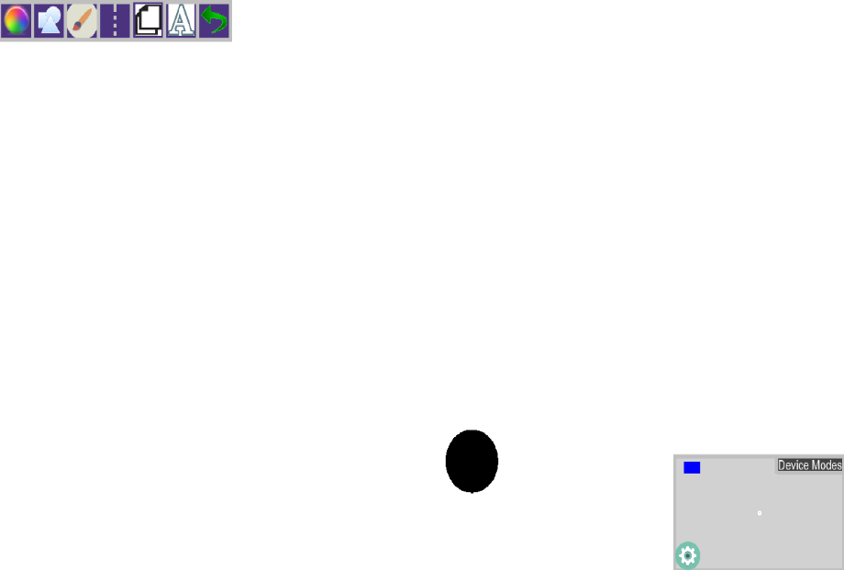
Features Demo: Drawing with the Kinect

Slide 28
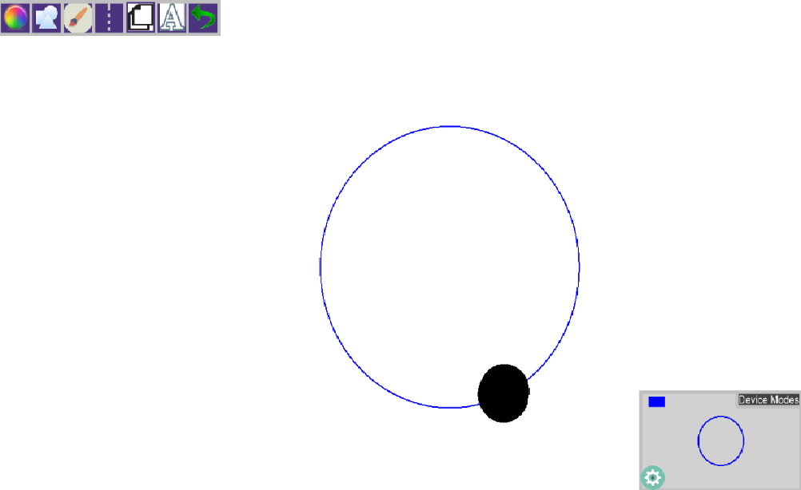
Continued:

